Slide 1
StudyPalz
Aakash Darda
Vishwakarma Institute of Technology, Pune

Slide 2

The Problem: The "One-Size-Fits-None" Approach
Static Content: Courses are rigid and don't adapt to individual learning speeds or styles.
Passive Learning: Students are forced into a passive role, leading to low engagement and motivation.
The Forgetting Curve is Real: 70% of new information is forgotten within 24 hours without reinforcement.
Hidden Knowledge Gaps: Students often don't realize what they don't know until the final exam, when it's too late.
The result? Wasted time, high stress, and poor long-term retention.

Slide 3
Our Solution: A Truly Personal Study Partner
Introducing StudyPalz, a hyper-personalized learning platform that can teach you anything.
From complex coding languages to the principles of space technology, StudyPalz transforms any subject into a dynamic, adaptive learning experience.
We don't offer a limited catalog of pre-built courses. Instead, we give you an intelligent AI partner that ingests any syllabus or topic you provide and builds a living, breathing curriculum perfectly tailored to your unique learning style, pace, and goals.
StudyPalz is not a website. It's your personal tutor for everything.

Slide 4
How It Works: The Adaptive Learning Loop (Innovation & Technical Feasibility)
Our entire system is built on a powerful, continuous feedback loop:
PLAN: A user inputs any syllabus or topic list. Our AI instantly analyzes it and generates a structured, day-by-day study plan.
LEARN: The user engages with AI-generated content—notes, analogies, code examples, and videos—all recommended based on their personal learning style.
VERIFY: To complete a lesson, the user must pass a short AI-generated quiz. This is our crucial, objective data point. No more just clicking "Mark as Done".
ADAPT: This is our secret sauce. Our AI analyzes quiz performance over time to model each user's personal Forgetting Curve. It then automatically schedules revision tasks before they are predicted to forget the information.

Slide 5
Innovation 1: The Proactive, Adaptive Scheduler
StudyPalz doesn't just give you a schedule; it manages it for you.
Forgetting Curve Modeling: We are the only platform that mathematically models how you forget information and acts on it.
Proactive Revision: Our AI automatically adds review sessions to your calendar for topics it predicts you're about to forget.
Dynamic Rescheduling: Missed a study day? The AI intelligently reschedules the task, so you never fall behind.
Targeted Quizzes: Daily, Weekly, and Surprise Quizzes are intelligently generated to target your specific weak spots and test your long-term memory.
This is the innovation: We've moved from a static to-do list to a proactive, intelligent system that guarantees long-term retention.

Slide 6
Innovation 2: Transparent AI & Personalized Insights
We believe AI should be a partner, not a black box.
AI on Every Page: Every action our AI takes is explained to the user. From why a quiz was generated to why a task was rescheduled, we build trust through transparency.
Learning Style Analysis: The system analyzes user interactions to identify their learning persona (e.g., "The Visualizer," "The Practitioner") and tailors content recommendations accordingly.
The "Aha!" Moment: Users don't just get a personalized experience; they understand why it's personalized, which dramatically increases engagement and trust in the system.

Slide 7
Technical Feasibility: Built on a Solid Foundation
Backend: Django (Python) provides a secure, powerful, and rapidly scalable foundation.
Core AI: We leverage the Google Gemini API for all our intelligent features, from generating entire study plans and quizzes to analyzing user performance and providing personalized insights.
Database: Started with SQLite for rapid prototyping, easily scalable to PostgreSQL for production needs.
Frontend: Simple HTML, CSS, and JavaScript, ensuring a fast, responsive user experience without heavy frameworks.
We have a working prototype that demonstrates every key feature we've discussed today.

Slide 8
The Impact: Transforming Learning Outcomes
The impact of StudyPalz is clear and measurable.
For Students:
Reduces Exam Stress: By eliminating the need for last-minute cramming.
Increases Efficiency: Focuses study time on areas that need the most attention.
Boosts Confidence: Users see a clear path to mastery and understand their own progress.
Improves Long-Term Retention: Our core loop is scientifically designed to move knowledge from short-term to long-term memory.
Market Potential: The global e-learning market is projected to reach over $600 billion by 2027. StudyPalz is perfectly positioned to capture a significant share in the test prep, higher education, and corporate training sectors.

Slide 9
The Team
Team: Aakash Darda - A Solo Developer
This entire, fully-functional platform was built by a single developer within the hackathon timeframe. This was only possible by leveraging AI not just as a feature, but as a core development partner.
AI as a Co-Pilot: I used AI for everything from generating boilerplate code and debugging complex issues to designing database schemas and crafting user-facing content.
Rapid Prototyping: This AI-augmented workflow allowed for an incredibly fast, agile, and iterative development process.
This project is a testament to a new paradigm of development. It proves that with the right tools, a single motivated individual can build complex, impactful solutions. There are no limits.

Slide 10
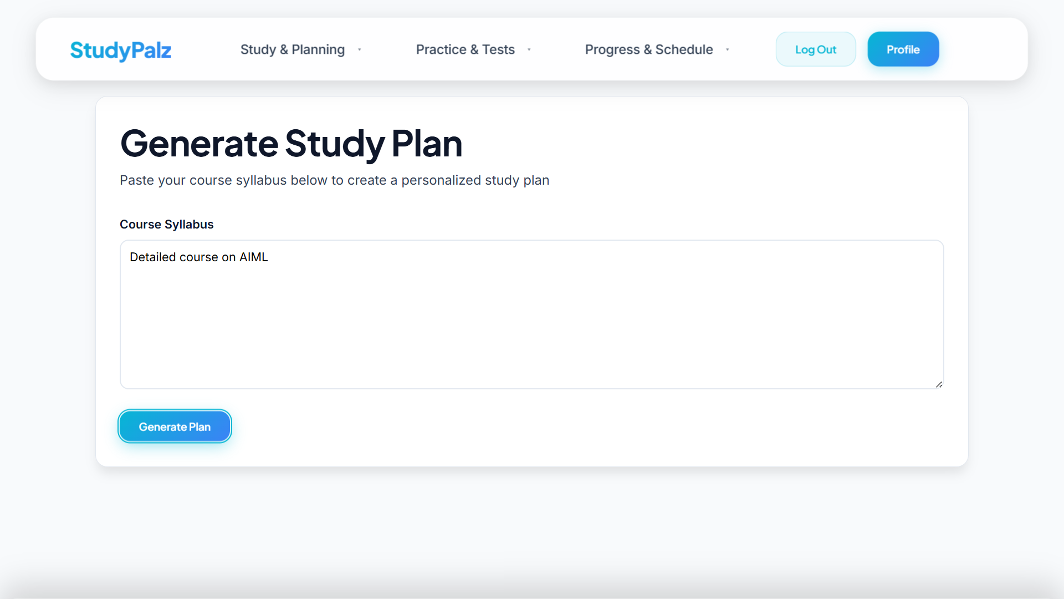
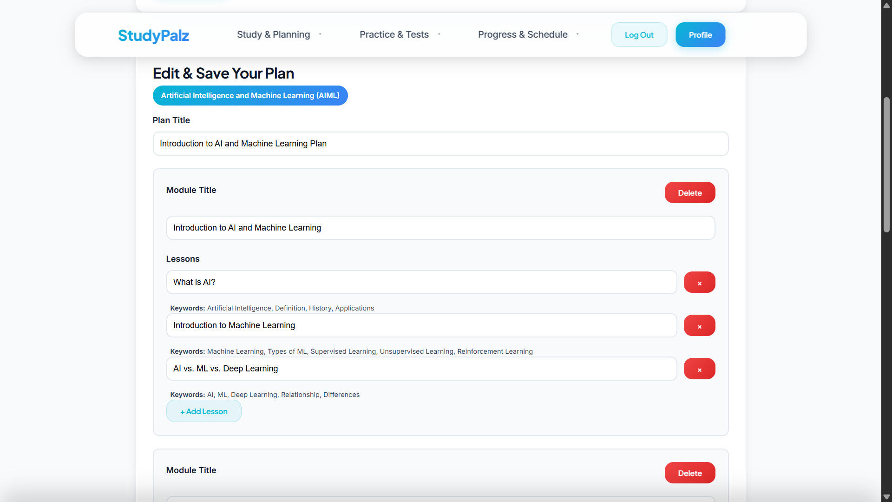
Working Model

Slide 11
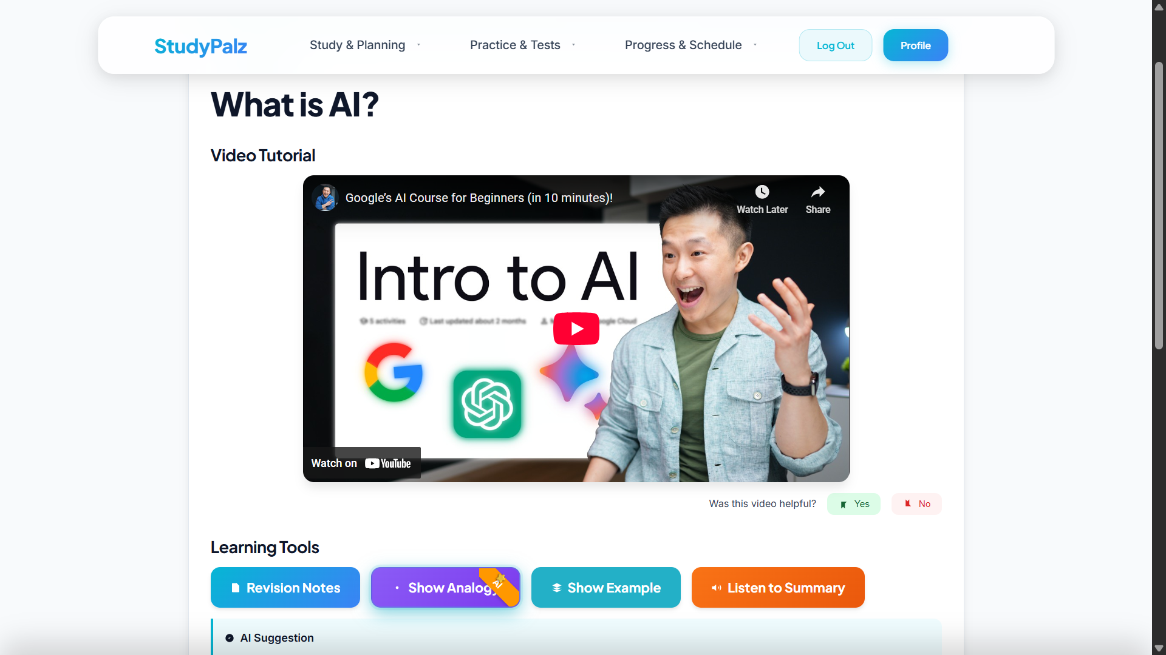
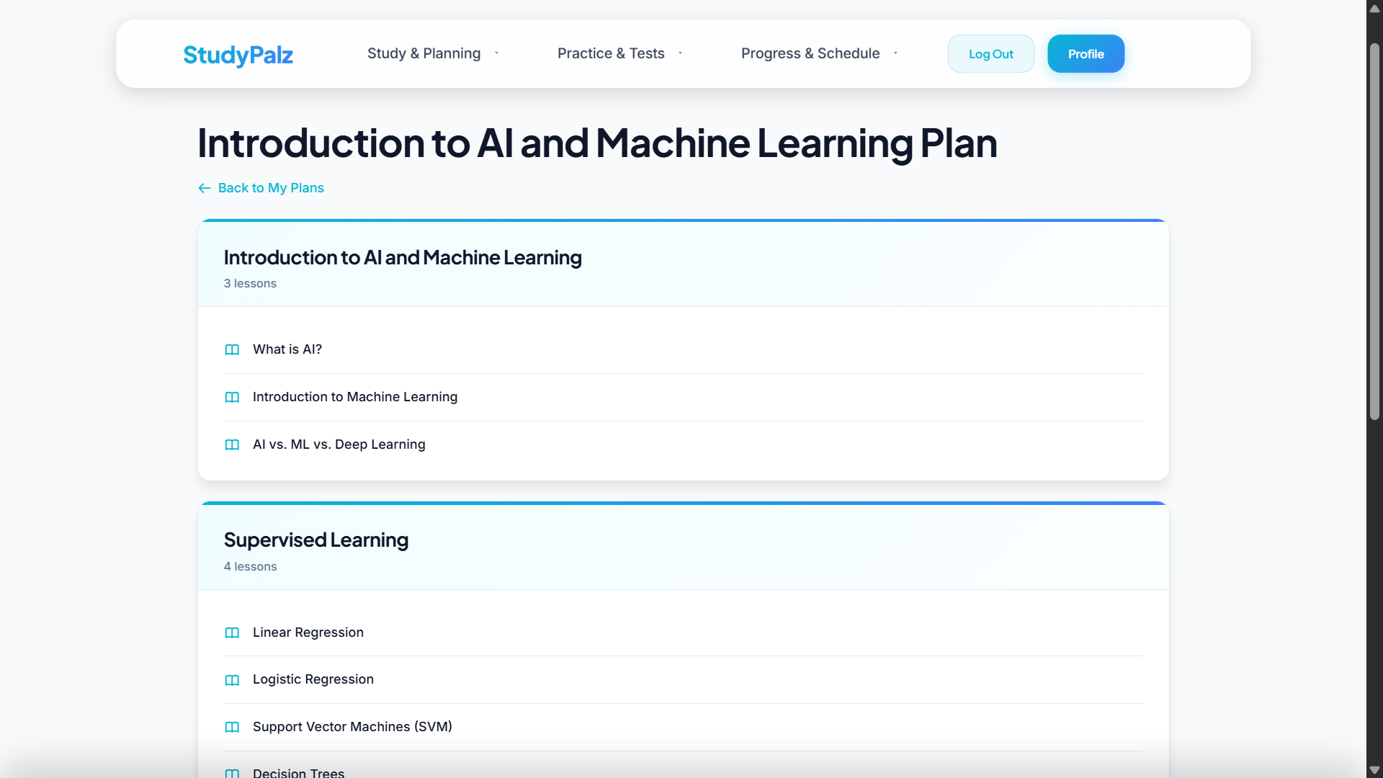
Working Model

Slide 12
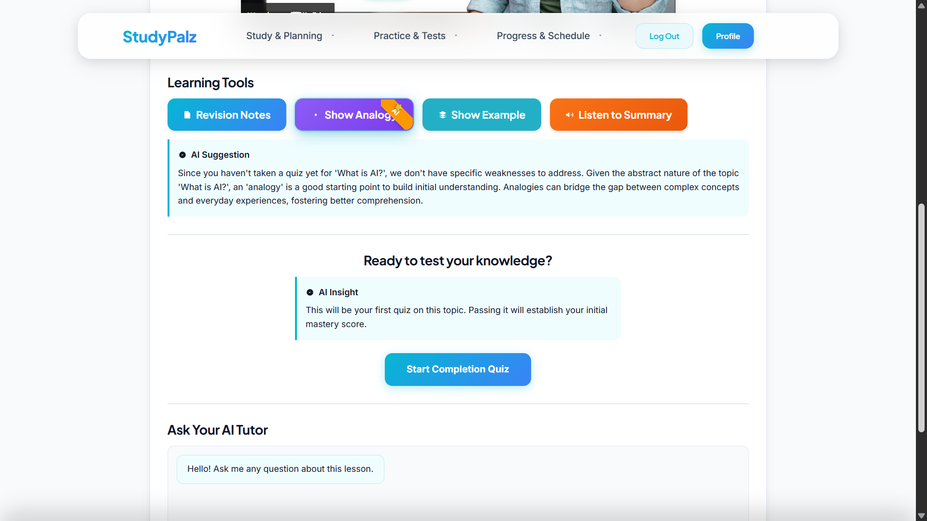
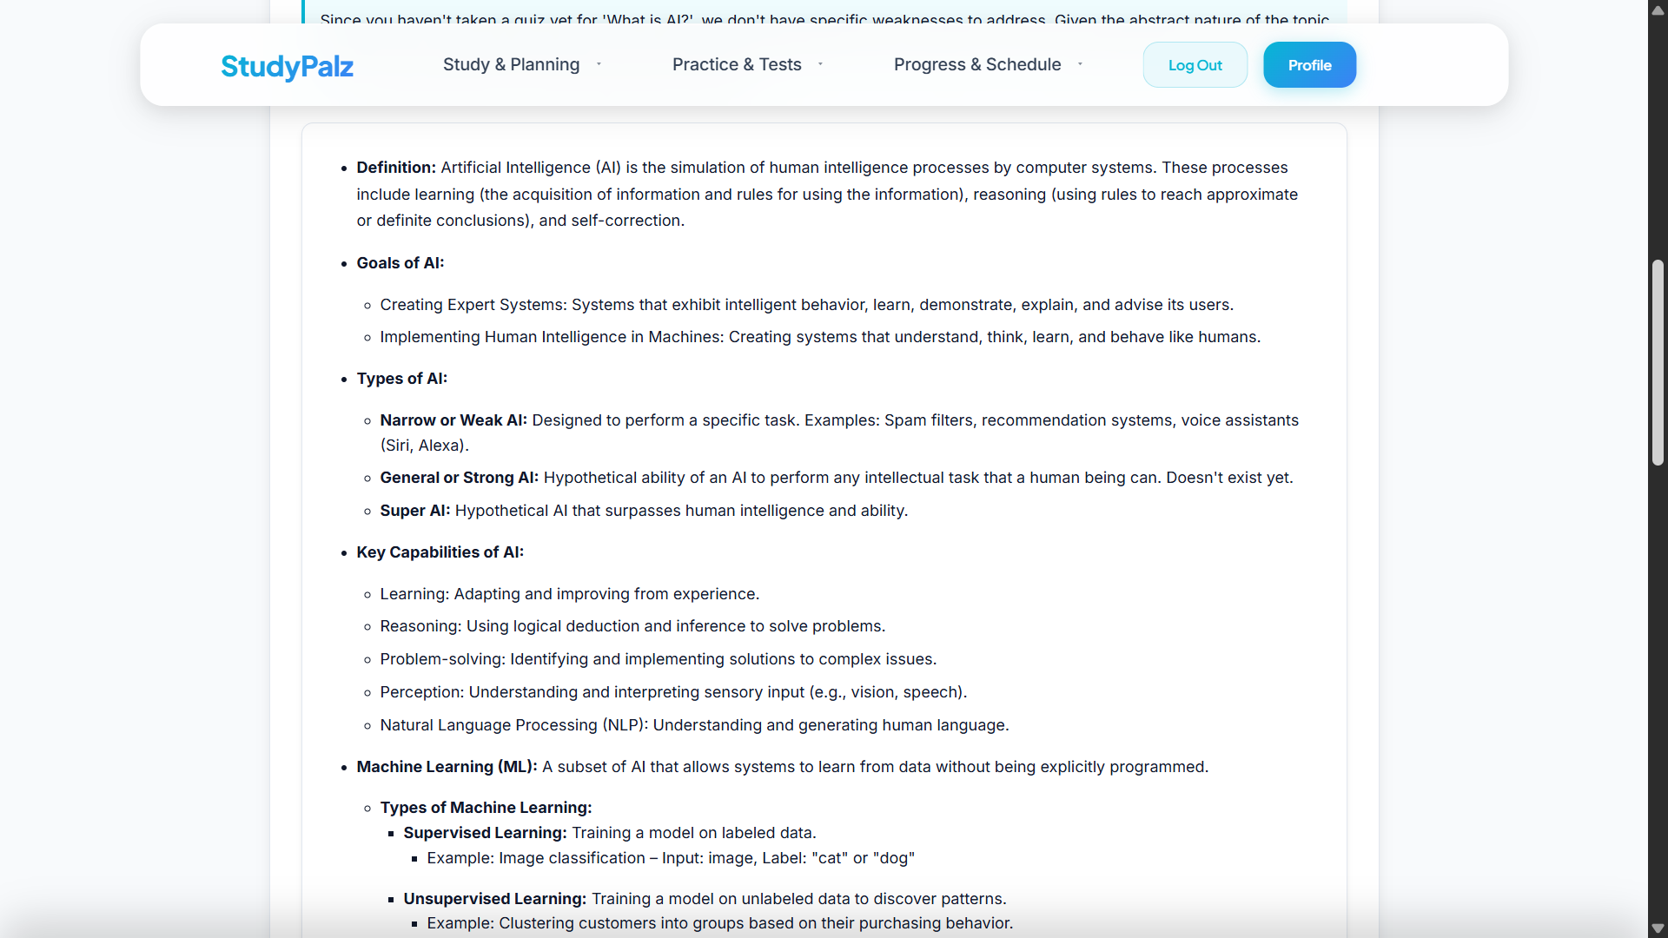
Working Model

Slide 13
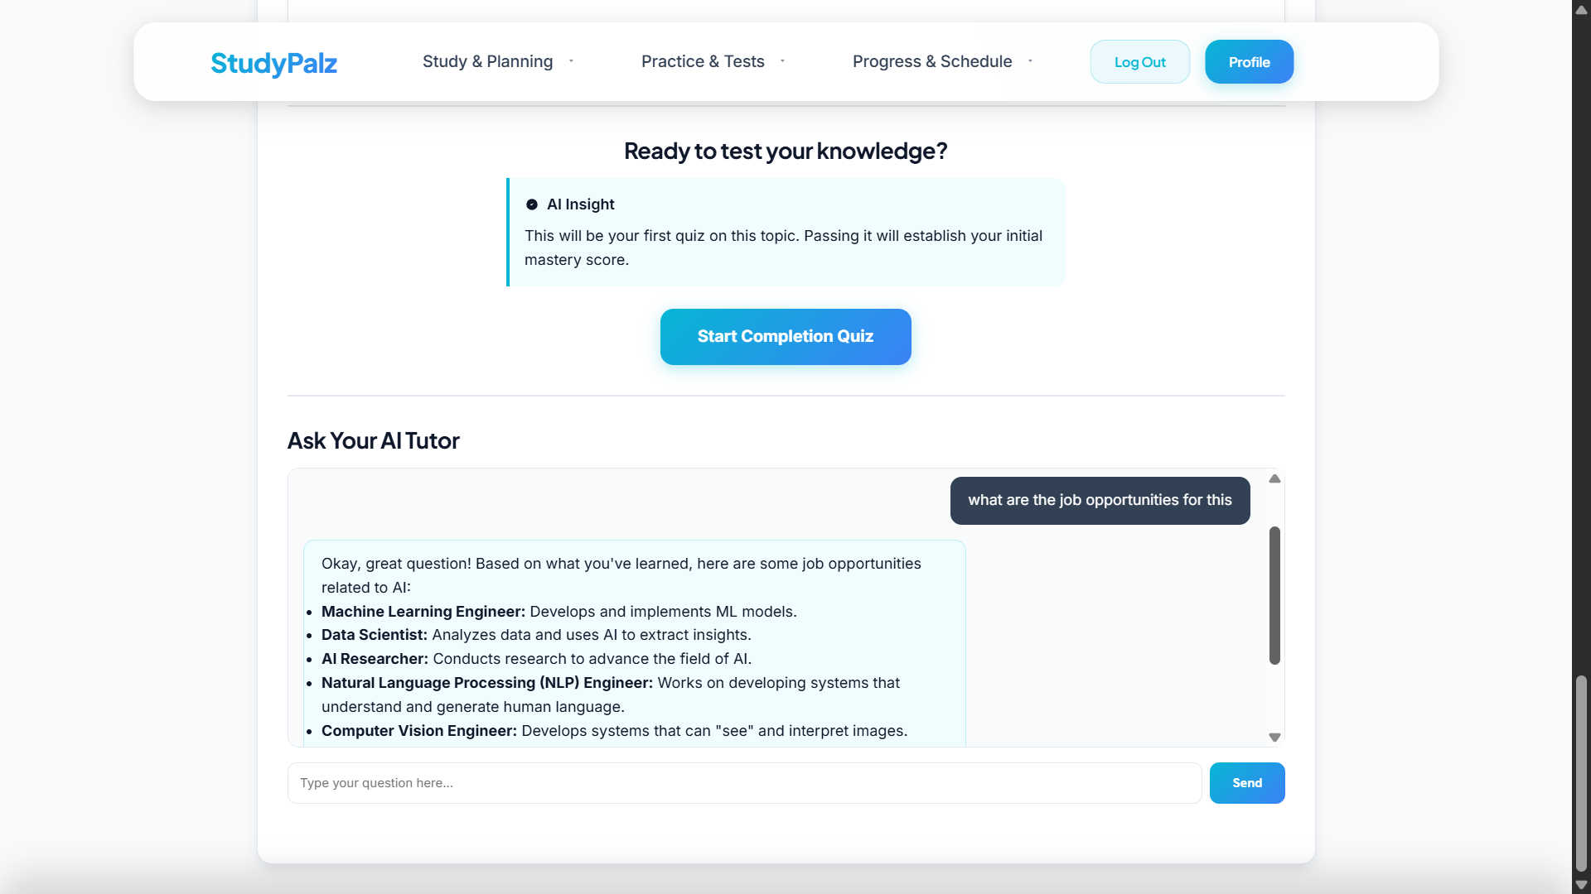
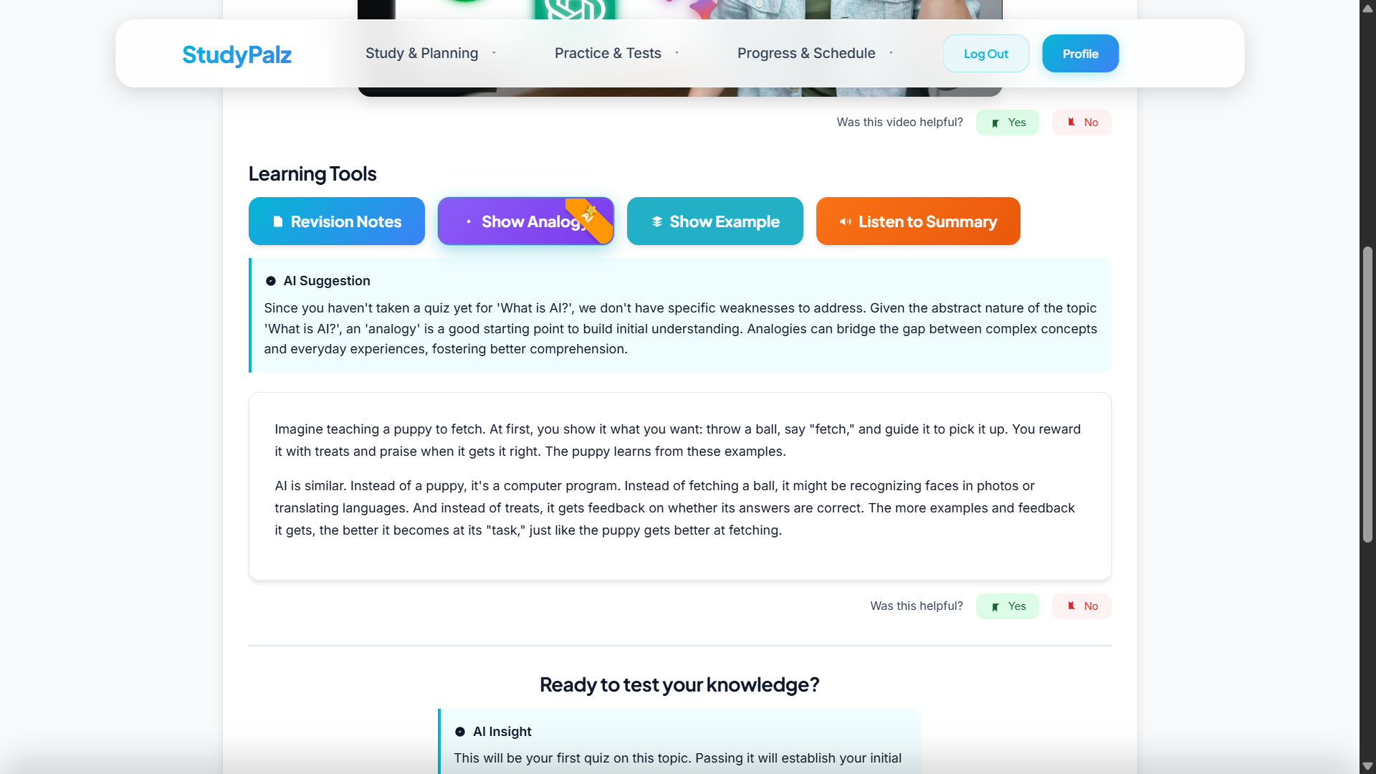
Working Model
Documentation: StudyPalz Project Overview : https://lnkd.in/gUBK5gyt

Slide 14
The Future: Where We Go From Here
StudyPalz is more than a platform; it's the foundation for the future of education. Our roadmap goes beyond simple features:
From Tutor to Socratic Mentor: We will evolve our AI from a Q&A bot into a true Socratic mentor. It will ask probing, thought-provoking questions to guide users to their own "aha!" moments, fostering critical thinking instead of just providing answers.
From Content Curation to Content Creation: Why just find videos when we can create them? We will leverage generative AI to create custom, short-form video explainers and interactive simulations on the fly, perfectly tailored to the user's specific point of confusion.
From Individual Learning to Enterprise & Academic Integration: We will develop an API that allows universities and corporations to plug StudyPalz directly into their existing learning management systems. We can provide a layer of deep personalization on top of their proprietary content, transforming their static courses into adaptive experiences at scale.

Slide 15
Thank You
StudyPalz – Palz
Aakash Darda

